Slide 1





Maven Tycho
In practice
Martin Schreiber
Bachmann electronic GmbH

Slide 2

Agenda
Background
How we built in the past
Why we switched to Tycho
Our Build with Tycho
How we develop multiple features in parallel

Slide 3


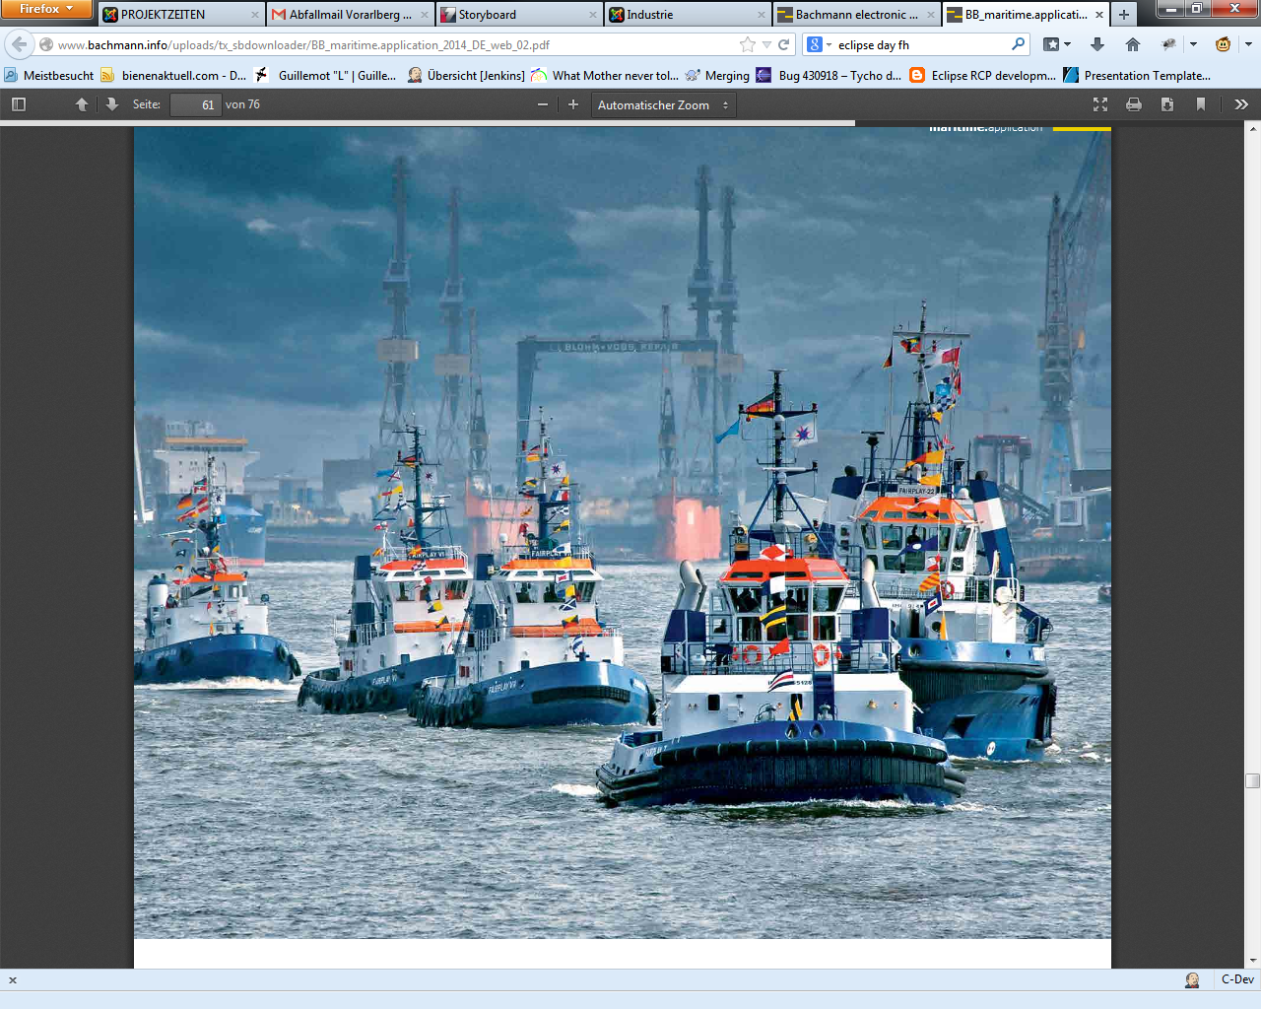

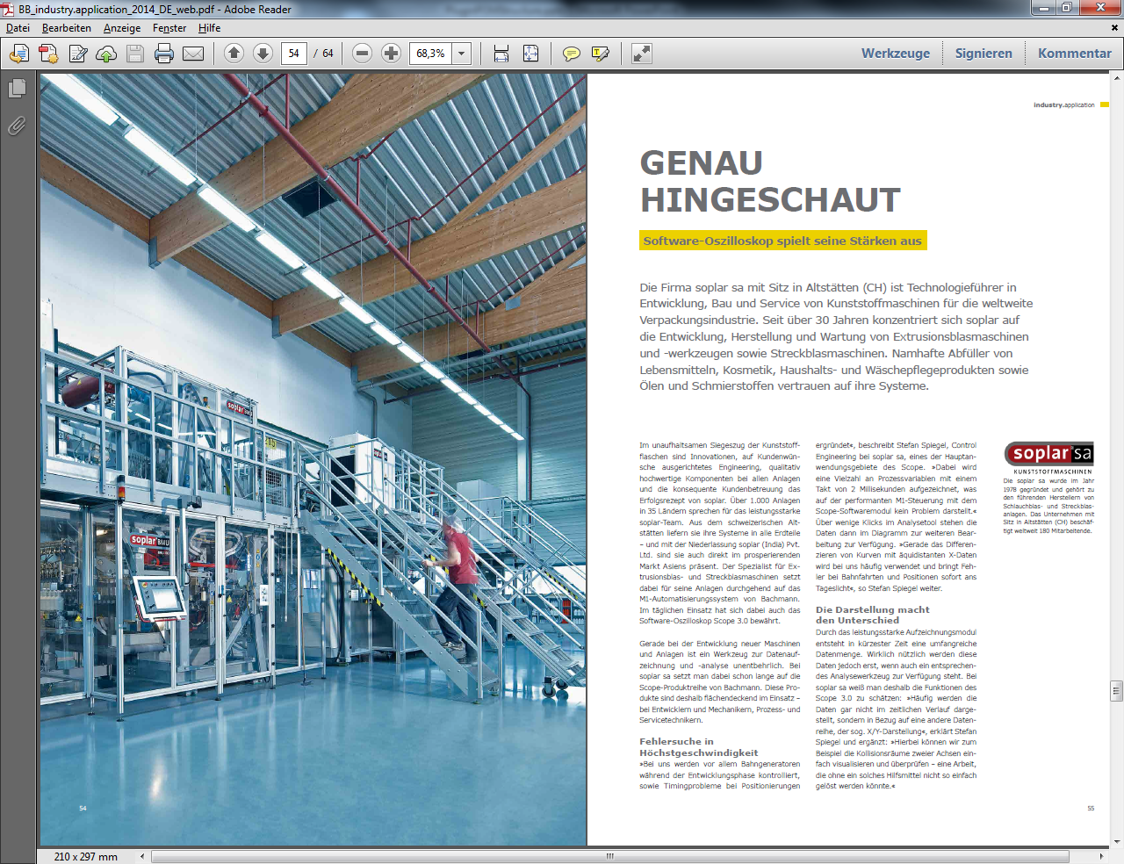

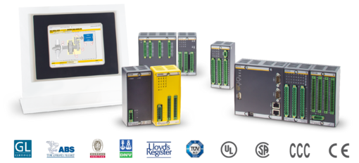
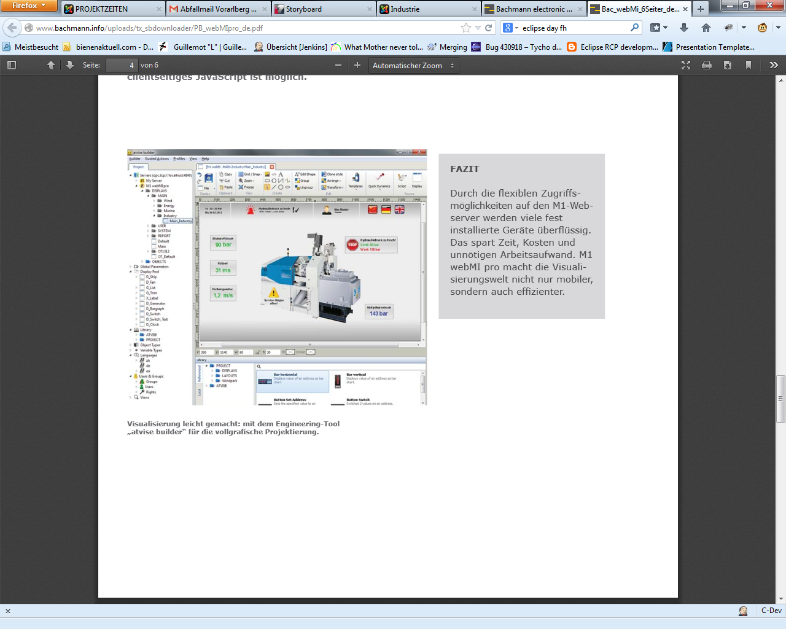
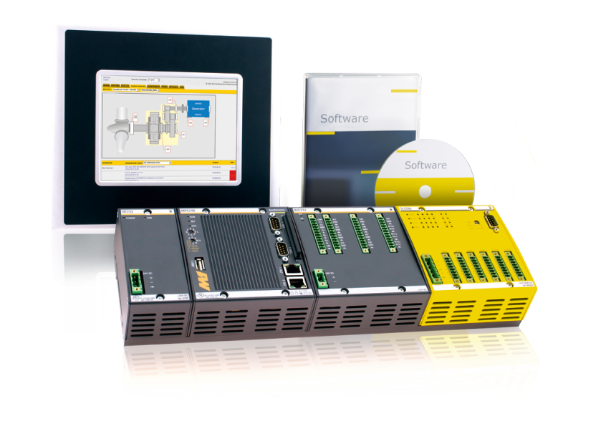
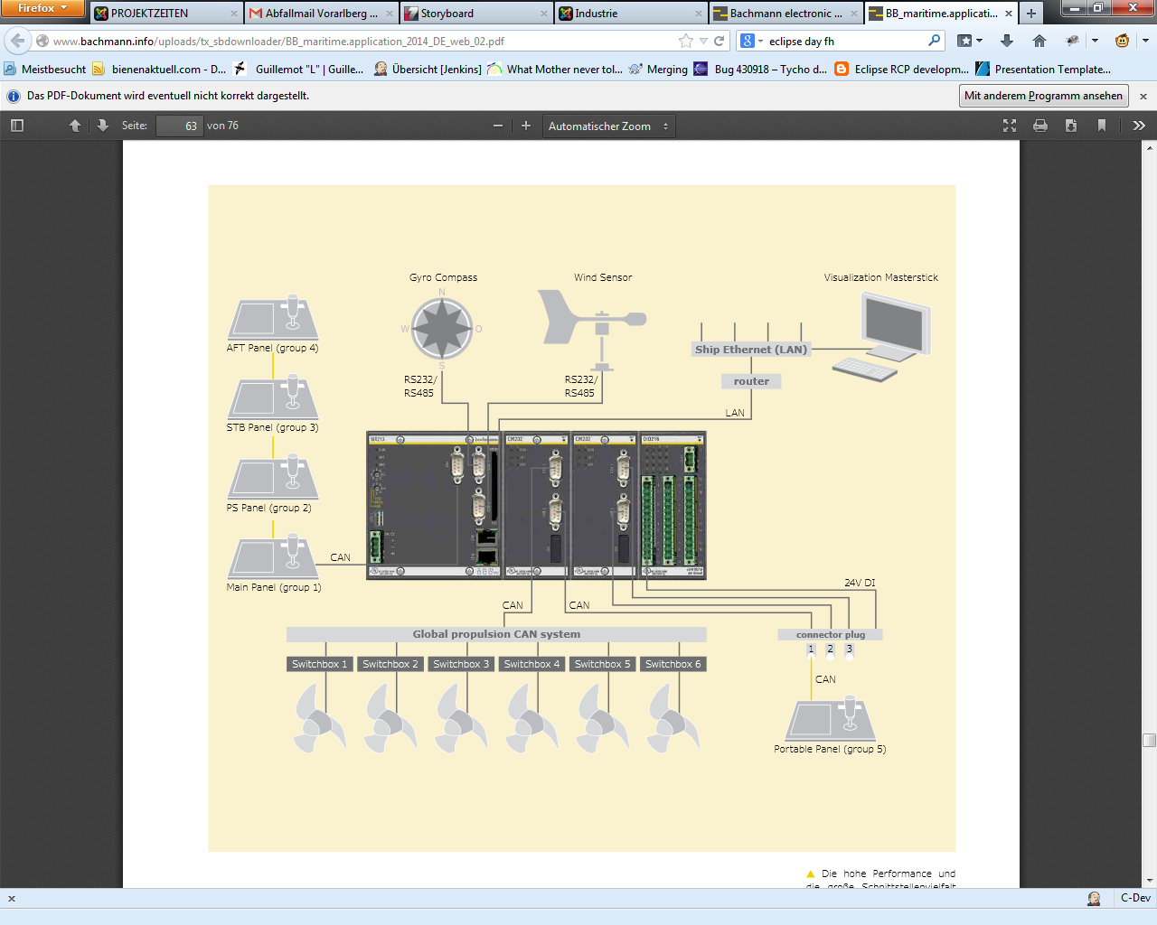
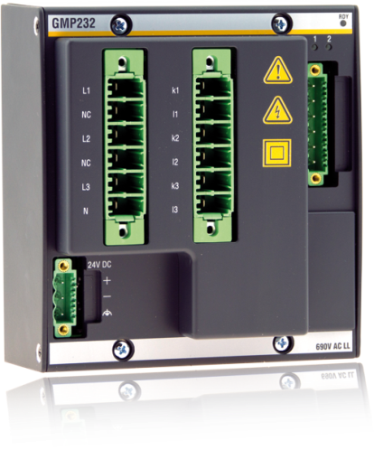
Bachmann electronic
Maritime Applications
Automation Systems
Wind Power Plants
Renewable Energy
Manufactoring Systems

Slide 4
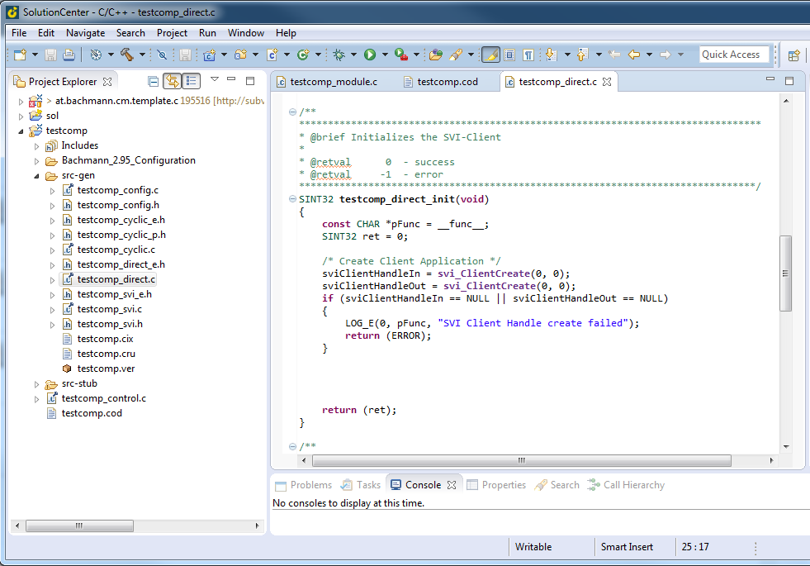
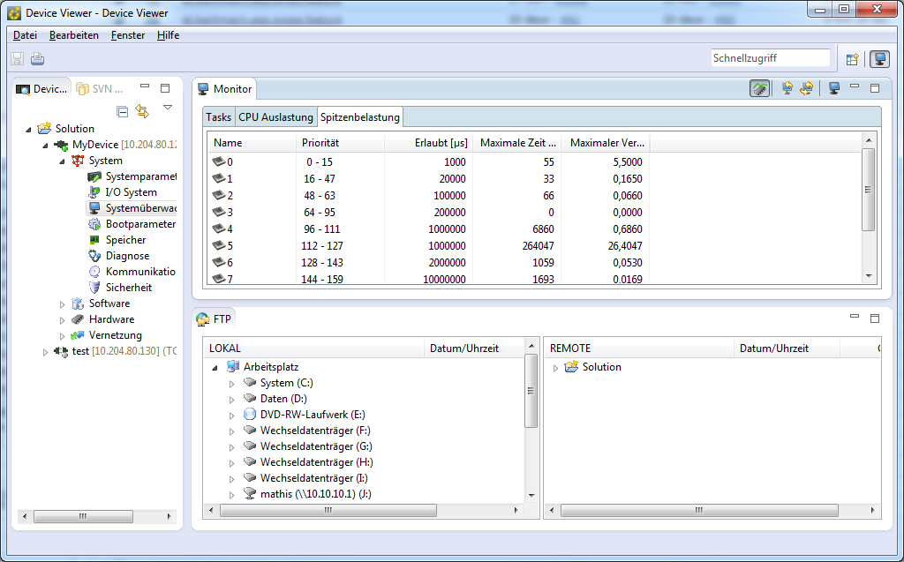
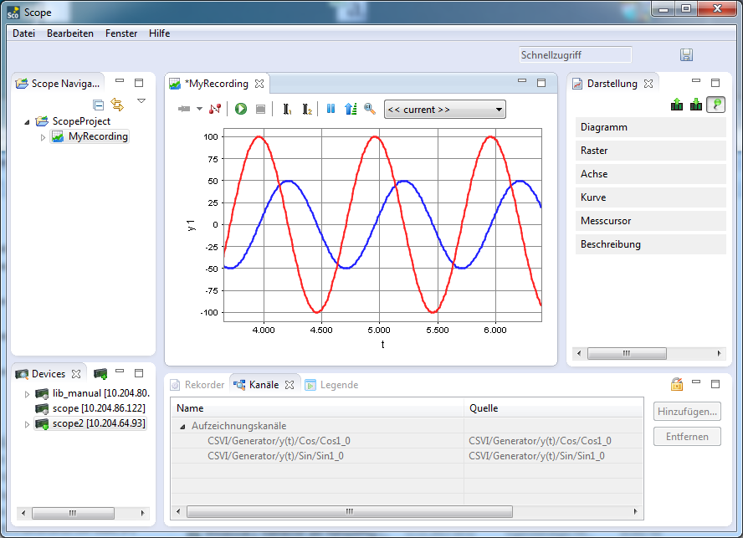
Our RCPs

Slide 5

What’s on our buildserver
5 RCPs
60 Features
300 Plugins
> 1 000 000 Lines of Code
Installers

Slide 6
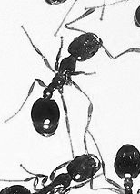
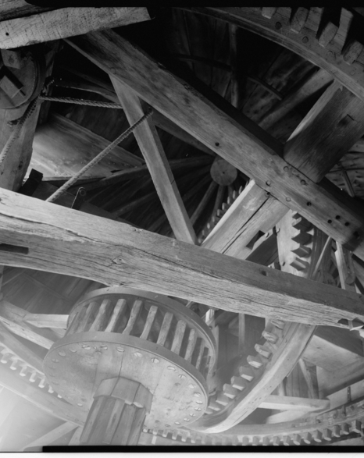
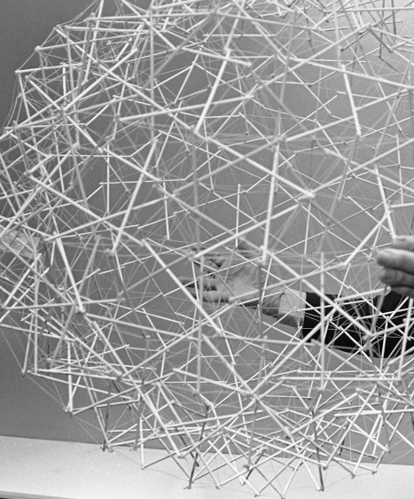
What we have used/tried
Ant4Eclipse
PDE Build
Buckminster
GIT

Slide 7

Goals with Tycho
Modular builds that reuses artifacts
Reduced number of checkouts per build
Faster feedback
Up to date build system

Slide 8
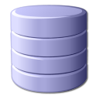




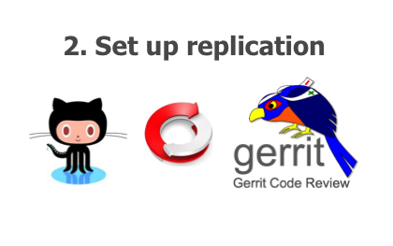


Our Build
P2 Repository Mirrors
Products
Tycho
Subversion
Git / Gerrit

Slide 9







Features / Plugins
Solution Center Product
C-Developer Feature
Debugger Plugin
FTP-Feature
C Templates Plugin
Profinet-Feature
C++ Templates Plugin
Ethercat-Feature

Slide 10



File System Structure
at.bachmann.sc.master.pom (Master POM)
/pom.xml
at.bachmann.cdeveloper.feature (Feature)
/feature.xml
/pom.xml
/build_pom/pom.xml
/p2_pom/pom.xml at.bachmann.cdev.ui (Plugin)
/META-INF/MANIFEST.MF
/src/…….
/plugin.xml
/pom.xml

Slide 11






POM Structure
Master POM
FEATURE Build POM
Feature POM
P2 POM
Plugin POM
Test Fragment POM

Slide 12
Master POM
<?xml version="1.0" encoding="UTF-8"?>
<project
xsi:schemaLocation="http://maven.apache.org/POM/4.0.0 http://maven.apache.org/xsd/maven-4.0.0.xsd"
xmlns="http://maven.apache.org/POM/4.0.0" xmlns:xsi="http://www.w3.org/2001/XMLSchema-instance">
<modelVersion>4.0.0</modelVersion>
<groupId>at.bachmann.solutioncenter</groupId>
<artifactId>solutioncenter</artifactId>
<name>SolutionCenter</name>
<version>1.0.0-SNAPSHOT</version>
<packaging>pom</packaging>
<properties>
<tycho-version>0.23.0</tycho-version>
<jacoco-version>0.6.4.201312101107</jacoco-version>
<jnario-version>0.7.5</jnario-version>
<xtend-version>2.6.3</xtend-version>
<buildhelper-version>1.8</buildhelper-version>
<maven-clean-version>2.5</maven-clean-version>
<antrun-version>1.7</antrun-version>
<sonar.java.source>1.7</sonar.java.source>
<sonar.java.target>1.7</sonar.java.target>
<sonar.jdbc.driverClassName>com.mysql.jdbc.Driver</sonar.jdbc.driverClassName>
<sonar.jdbc.url>jdbc:mysql://buildserver:3306/sonar?useUnicode=true&amp;characterEncoding=utf8</sonar.jdbc.url>
<sonar.host.url>http://buildserver:9000</sonar.host.url>
<sonar.jacoco.reportPath>${WORKSPACE}/jacoco.exec</sonar.jacoco.reportPath>
<sonar.dynamicAnalysis>reuseReports</sonar.dynamicAnalysis>
<sonar.findbugs.timeout>6000000</sonar.findbugs.timeout>
<java.io.tmpdir>${WORKSPACE}/temp</java.io.tmpdir>
<osgi.arch>x86</osgi.arch>
</properties>
General Settings shared by all POMs

Slide 13
Plugin POM
<?xml version="1.0" encoding="UTF-8"?>
<project xsi:schemaLocation="http://maven.apache.org/POM/4.0.0 http://maven.apache.org/xsd/maven-4.0.0.xsd"
xmlns="http://maven.apache.org/POM/4.0.0" xmlns:xsi="http://www.w3.org/2001/XMLSchema-instance">
<modelVersion>4.0.0</modelVersion>
<groupId>at.bachmann.solutioncenter</groupId>
<artifactId>at.bachmann.cdt.ui</artifactId>
<version>1.0.0-SNAPSHOT</version>
<packaging>eclipse-plugin</packaging>
<parent>
<relativePath>../at.bachmann.cdeveloper.feature/build_pom</relativePath>
<groupId>at.bachmann.solutioncenter</groupId>
<artifactId>at.bachmann.cdeveloper.feature.pom</artifactId>
<version>1.0.0-SNAPSHOT</version>
</parent>
</project>
A single Plugin

Slide 14

Test Fragment POM
<?xml version="1.0" encoding="UTF-8"?>
<project
xsi:schemaLocation=http://maven.apache.org/POM/4.0.0 http://maven.apache.org/xsd/maven-4.0.0.xsd>
<modelVersion>4.0.0</modelVersion>
<groupId>at.bachmann.solutioncenter</groupId>
<artifactId>at.bachmann.cdt.ui.test</artifactId>
<version>1.0.0-SNAPSHOT</version>
<packaging>eclipse-test-plugin</packaging>
<parent>
<relativePath>../at.bachmann.cdeveloper.feature/build_pom</relativePath>
<groupId>at.bachmann.solutioncenter</groupId>
<artifactId>at.bachmann.cdeveloper.feature.pom</artifactId>
<version>1.0.0-SNAPSHOT</version>
</parent>
<build>
<plugins>
<plugin> <!– Creates the Jnario Features/Specs/Suites -->
<groupId>org.jnario</groupId>
<artifactId>jnario-maven-plugin</artifactId>
<version>${jnario-version}</version>
<executions>
<execution>
<goals>
<goal>testCompile</goal>
<goal>xtend-test-install-debug-info</goal>
</goals>
<configuration>
<testOutputDirectory>${basedir}/xtend-gen</testOutputDirectory>
<outputDirectory>${basedir}/xtend-gen</outputDirectory>
</configuration>
</execution>
</executions>
</plugin>
</plugins>
</build>
</project>
Build
Specfic Settings
Builds a Test Fragment
Notes:
Test Fragment that generates the test code during the build
-> JNARIO Test Framework
-> still a generic pom file for test plugins

Slide 15

Feature Build POM
<?xml version="1.0" encoding="UTF-8"?>
<project>
<modelVersion>4.0.0</modelVersion>
<groupId>at.bachmann.solutioncenter</groupId>
<artifactId>at.bachmann.cdeveloper.feature.pom</artifactId>
<version>1.0.0-SNAPSHOT</version>
<packaging>pom</packaging>
<parent>
<relativePath>../../at.bachmann.sc.master.pom</relativePath>
<groupId>at.bachmann.solutioncenter</groupId>
<artifactId>solutioncenter</artifactId>
<version>1.0.0-SNAPSHOT</version>
</parent>
<repositories>
<repository>
<id>at.bachmann.lib.core.feature</id>
<layout>p2</layout> <url>${JENKINS_URL}/job/at.bachmann.lib.core.feature/lsb/at.bachmann.lib.core.feature/p2_pom/target/repo</url>
</repository>
<repository>
<id>at.bachmann.core.feature</id>
<layout>p2</layout>
<url>${JENKINS_URL}/job/at.bachmann.core.feature/lsb/at.bachmann.core.feature/p2_pom/target/repo</url>
</repository>
</repositories>
<modules>
<module>../../at.bachmann.cdt.ui</module>
<module>../../at.bachmann.cdt.templates</module>
<module>../../at.bachmann.cdt.gdb.ui</module>
<module>../../at.bachmann.cdeveloper.feature</module>
<module>../../at.bachmann.cdeveloper.feature/p2_pom</module>
<module>../../at.bachmann.cdt.testbase</module>
<module>../../at.bachmann.cdt.ui.test</module>
<module>../../at.bachmann.cdt.toolchain.test</module>
</modules>
Dependency Update Sites
Plugins,
Tests, Feature,
Update Site
Builds a complete Feature

Slide 16
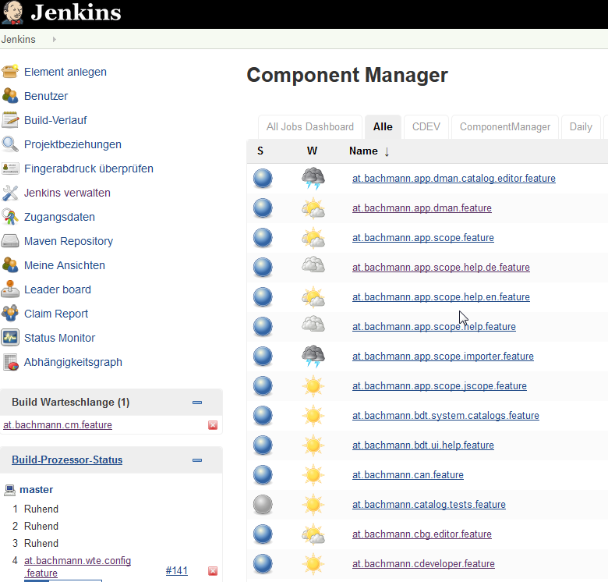
Jenkins
C-Developer Feature
FEATURE Build POM
FTP-Feature
FEATURE Build POM
Profinet-Feature
FEATURE Build POM
Ethercat-Feature
FEATURE Build POM

Slide 17
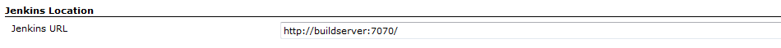
Feature Dependency
Feature Build POM
<url>${JENKINS_URL}/job/at.bachmann.lib.core.feature/p2_pom/target/repo</url>
Jenkins Configuration
Command Line
~$ mvn clean install –DJENKINS_URL=http://buildserver:7373

Slide 18
Branches
Product-Feature B
Product-Feature A
Stable Trunk

Slide 19
Branches
Product Feature Branch
Trunk
JENKINS_URL=
http://trunkbuildserver:7070
C-Developer Feature
FTP Feature
Core Software Feature
Lib Core Feature

Slide 20
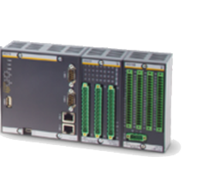








Master POM
<!-- Profile for Test plugins that uses the SC-Jenkins-Devices -->
<profile>
<id>SC-Jenkins-Devices</id>
<build>
<plugins>
<plugin>
<groupId>org.eclipse.tycho</groupId>
<artifactId>tycho-surefire-plugin</artifactId>
<version>${tycho-version}</version>
<configuration>
<systemProperties>
<m1.0>10.204.80.121</m1.0><m1.0.usr>ccontrol</m1.0.usr>
</systemProperties>
</configuration>
</plugin>
</plugins>
</build>
</profile>
<!-- Profile for Test plugins that uses the SC-Jenkins-Devices for Branch 2-->
<profile>
<id>SC-Jenkins-Devices-Branch2</id>
<build>
<plugins>
<plugin>
<groupId>org.eclipse.tycho</groupId>
<artifactId>tycho-surefire-plugin</artifactId>
<version>${tycho-version}</version>
<configuration>
<systemProperties>
<m1.0>10.204.80.130</m1.0><m1.0.usr>ccontrol</m1.0.usr>
</systemProperties>
</configuration>
</plugin>
</plugins>
1
2
Profiles for different build specific settings

Slide 21
Lessons learned
Branch specific settings must not be in sourcecode
Modular builds can improve structure of code
Building and testing with tycho shortens feedback time and gives more targeted feedback
With multiple Jenkins instances we can have both modular builds and multiple branches

Slide 22

THANK YOU
martin.schreiber@bachmann.info

